Slide 1
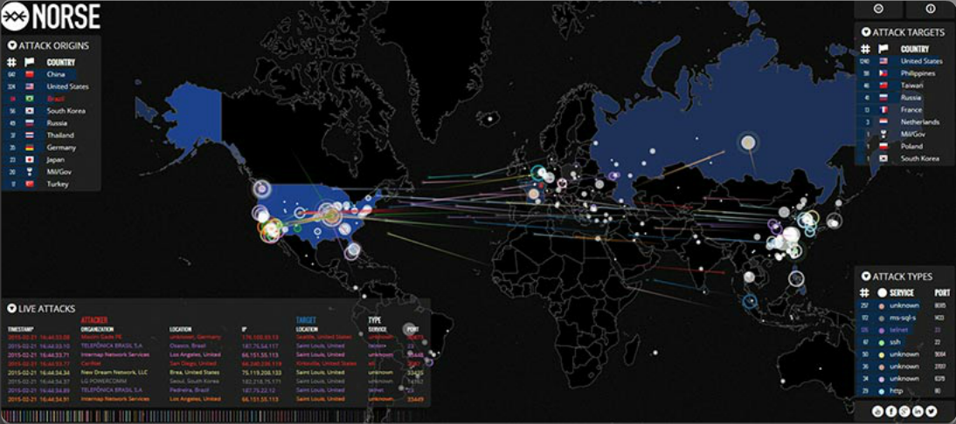
Networks Are Targets
Notes:
1.1.1.1 Networks Are Targets
http://map.ipviking.com/

Slide 2
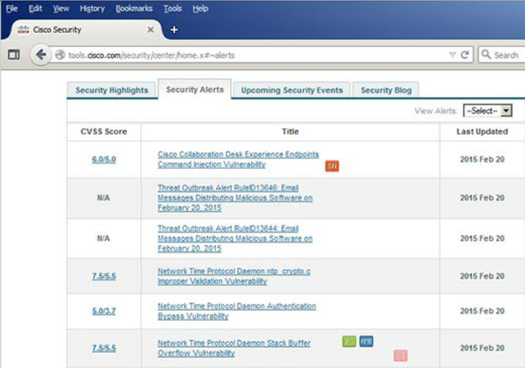
Drivers for Network Security
Common network security terms:
Threat
Vulnerability
Mitigation
Risk
Cisco Security Intelligence Operations
Notes:
1.1.1.2 Drivers for Network Security

Slide 3
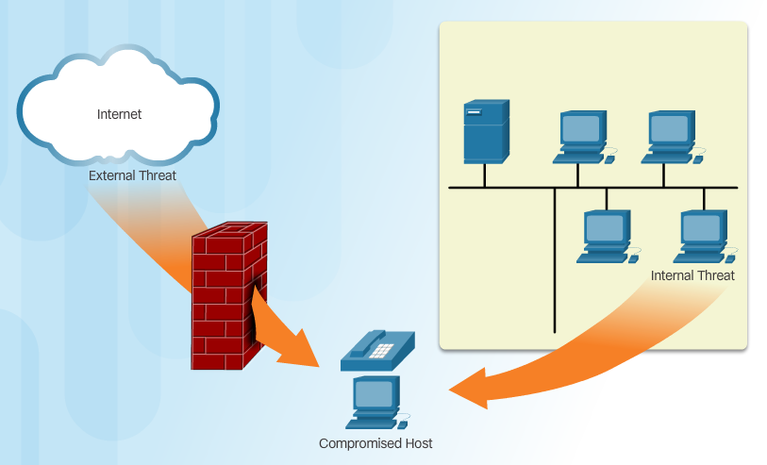
Vectors of Network Attacks
Notes:
1.1.1.3 Vectors of Network Attacks

Slide 4
Data Loss
Vectors of data loss:
Email/Webmail
Unencrypted Devices
Cloud Storage Devices
Removable Media
Hard Copy
Improper Access Control
Notes:
1.1.1.4 Data Loss

Slide 5
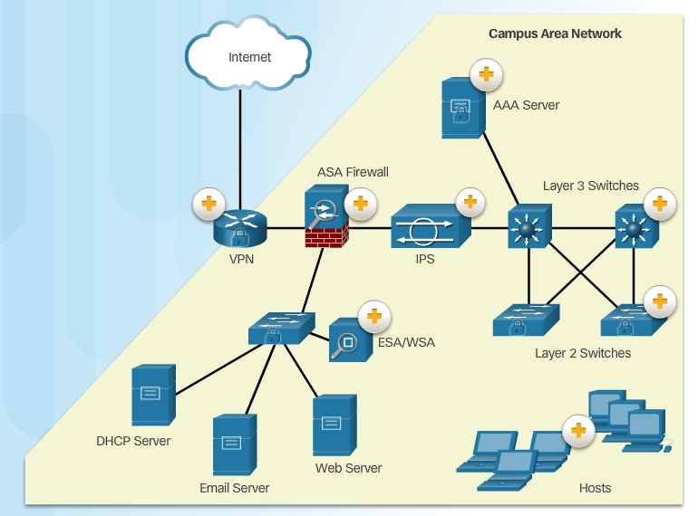
Campus Area Networks
Notes:
1.1.2.1 Campus Area Networks

Slide 6
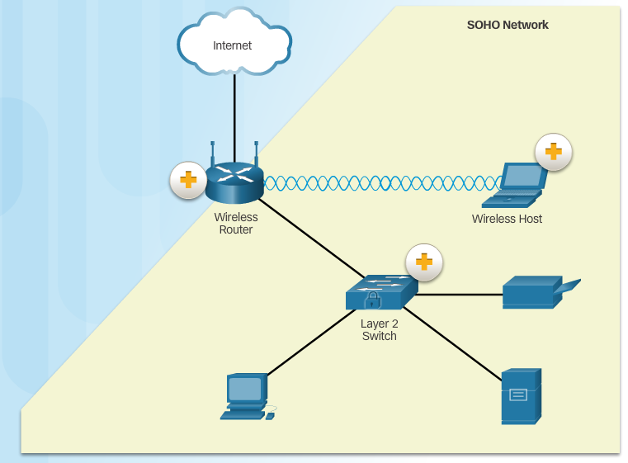
Small Office and Home Office Networks
Notes:
1.1.2.2 Small Office and Home Office Networks

Slide 7
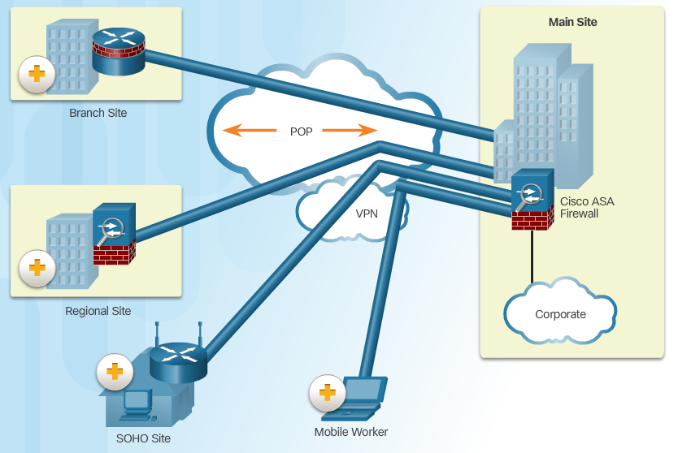
Wide Area Networks
Notes:
1.1.2.3 Wide Area Networks

Slide 8
Data Center Networks
Outside perimeter security:
On-premise security officers
Fences and gates
Continuous video surveillance
Security breach alarms
Inside perimeter security:
Electronic motion detectors
Security traps
Continuous video surveillance
Biometric access and exit sensors
Notes:
1.1.2.4 Data Center Networks

Slide 9
Cloud and Virtual Networks
VM-specific threats:
Hyperjacking
Instant On activation
Antivirus storm
Components of a secure data center:
Secure segmentation
Threat defense
Visibility
The Evolving Network Border
Critical MDM functions for BYOD network:
Data encryption
PIN enforcement
Data wipe
Data loss prevention
Jailbreak/root detection
Notes:
1.1.2.5 Cloud and Virtual Networks
1.1.2.6 The Evolving Network Border
1.1.2.7 Activity - Network Topology Protection Overview

Slide 10

The Hacker & The Evolution of Hackers
Modern hacking titles:
Script Kiddies
Vulnerability Brokers
Hacktivists
Cyber Criminals
State-Sponsored Hackers
Notes:
1.2.1.1 The Hacker
1.2.1.2 The Evolution of Hackers
1.2.1.3 Cyber Criminals
1.2.1.4 Hacktivists
1.2.1.5 State-Sponsored Hackers

Slide 11
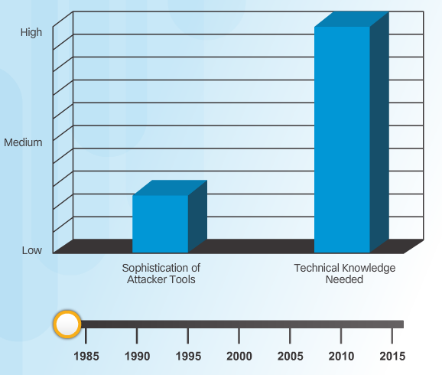
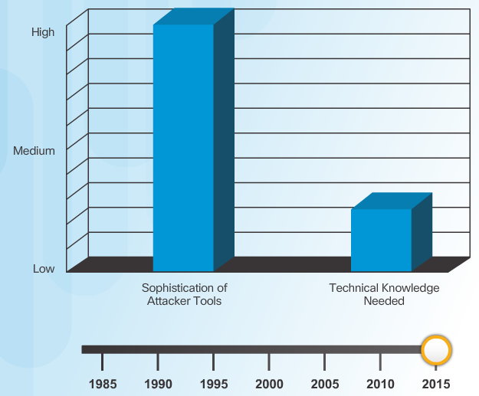
Introduction of Attack Tools
Notes:
1.2.2.1 Introduction of Attack Tools

Slide 12
Evolution of Security Tools
Penetration testing tools:
Password crackers
Wireless hacking
Network scanning and hacking
Packet crafting
Packet sniffers
Rootkit detectors
Fuzzers to search vulnerabilities
Forensic
Debuggers
Hacking operating systems
Encryption
Vulnerability exploitation
Vulnerability Scanners
Notes:
1.2.2.2 Evolution of Security Tools

Slide 13
Categories of Attack Tools
Network hacking attacks:
Eavesdropping
Data modification
IP address spoofing
Password-based
Denial-of-service
Man-in-the-middle
Compromised-key
Sniffer
Notes:
1.2.2.3 Categories of Attack Tools

Slide 14
Types of Network Attacks
Data Modification
Syn Flood
Smurf Attack
Reconnaissance Access DoS
Notes:
1.1.1.1 Networks Are Targets

Slide 15

Reconnaissance Attacks
Initial query of a target
Ping sweep of the target network
Port scan of active IP addresses
Vulnerability scanners
Exploitation tools
Notes:
1.2.4.2 Reconnaissance Attacks
1.2.4.3 Sample Reconnaissance Attacks

Slide 16
Access Attacks
A few reasons why hackers use access attacks:
To retrieve data
To gain access
To escalate access privileges
A few types of access attacks include:
Password
Trust exploitation
Port redirection
Man-in-the-middle
Buffer overflow
IP, MAC, DHCP spoofing
Notes:
1.2.4.5 Access Attacks
1.2.4.6 Types of Access Attacks

Slide 17
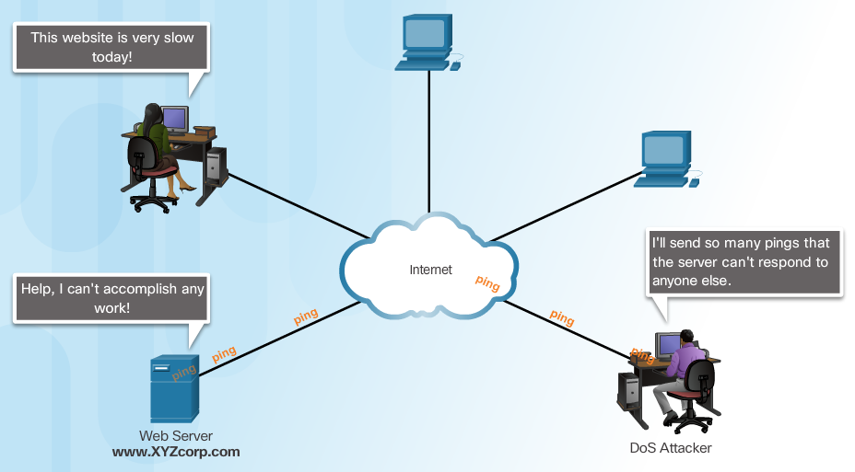
Denial of Service Attacks
Notes:
1.2.4.7 Denial of Service Attacks
1.2.4.8 Types of DoS Attacks

Slide 18
DDoS Attacks
Hacker builds a network of infected machines
A network of infected hosts is called a botnet.
The compromised computers are called zombies.
Zombies are controlled by handler systems.
Zombie computers continue to scan and infect more targets
Hacker instructs handler system to make the botnet of zombies carry out the DDoS attack
Notes:
1.2.4.9 DDoS Attacks
1.2.4.10 DDoS Attacks (cont.) - Video https://www.youtube.com/watch?v=NogCN78XN2w
1.2.4.11 Activity - Identify the Types of Attack
1.2.4.12 Lab - Social Engineering

Slide 19
Defending the Network
Best practices:
Develop a written security policy.
Educate employees about the risks of social engineering, and develop strategies to validate identities over the phone, via email, or in person.
Control physical access to systems.
Use strong passwords and change them often.
Encrypt and password-protect sensitive data.
Implement security hardware and software.
Perform backups and test the backed up files on a regular basis.
Shut down unnecessary services and ports.
Keep patches up-to-date by installing them weekly or daily to prevent buffer overflow and privilege escalation attacks.
Perform security audits to test the network.
Notes:
1.3.4.1 Defending the Network

Slide 20
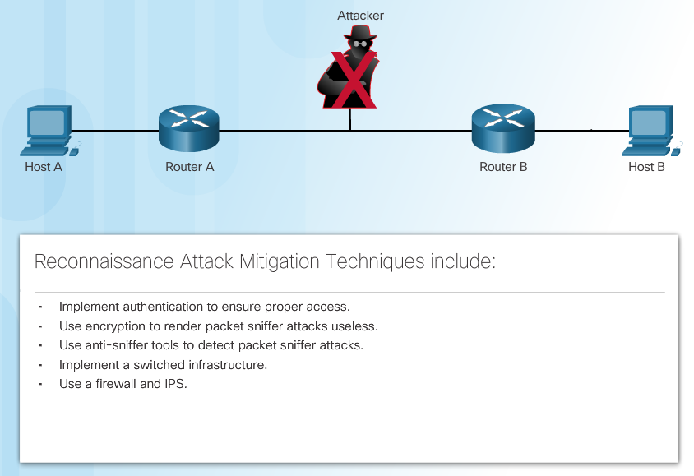
Mitigating Reconnaissance Attacks
Notes:
1.3.4.4 Mitigating Reconnaissance Attacks

Slide 21
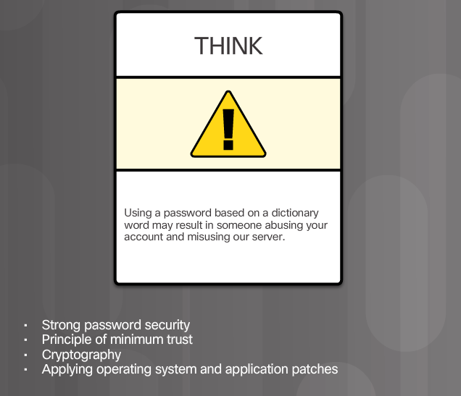
Mitigating Access Attacks
Notes:
1.3.4.5 Mitigating Access Attacks

Slide 22
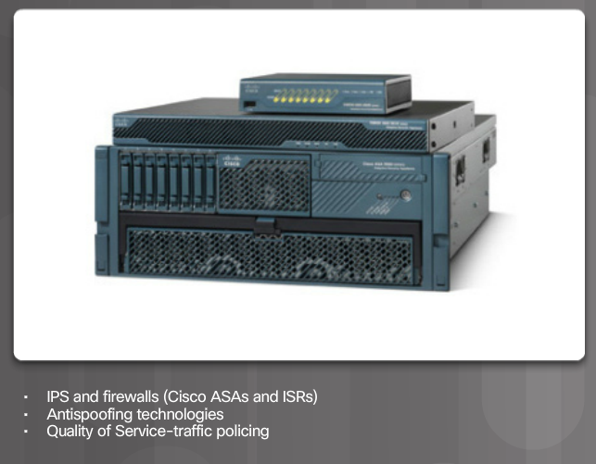
Mitigating DoS Attacks
Notes:
1.3.4.6 Mitigating DoS Attacks

